Slide 1


DATS 6501 – Capstone Project Group 7
Forecasting NYC Subway Ridership
By
Krishnasurya Gopalakrishnan,
Monica Muniraj

Slide 2

Introduction
This capstone project delivers a data-driven solution for transit operations and planning through an enterprise-grade, highly scalable, and reproducible cloud-native big data analytics pipeline to forecast NYC subway ridership.

Slide 3
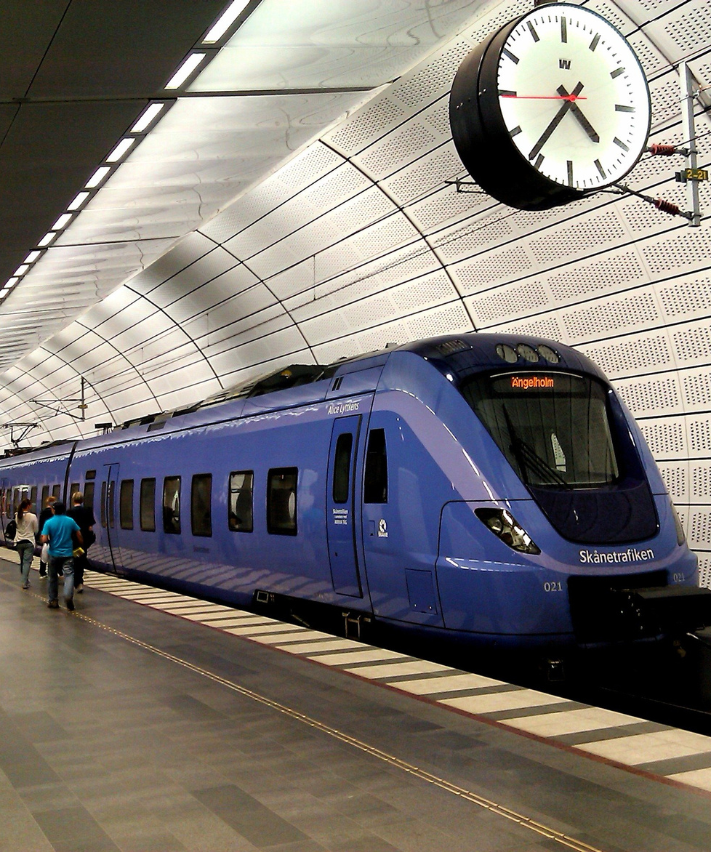
Problem Statement
Current scenario:
Transit Capacity planning is critical for minimizing service disruptions, reducing overcrowding, and preventing long wait times for commuters.
NYC subway being one of the busiest transport system accommodates millions of daily riders, making forecasting crucial for daily operations, staffing, budgeting, and long-term maintenance planning.
There is a clear need for a highly scalable forecasting solution that integrates both recent and historical data to provide timely, accurate, and adaptable ridership insights.

Slide 4

Methodology
Used Infrastructure as Code (IaC) to create, configure, and maintain all cloud resources required for the pipeline
Built an ELT pipeline based on the Medallion Architecture, an industry-standard data design pattern that promotes modular and incremental data accomodation
Automated the entire workflow, from raw data ingestion to model training, prediction, and forecast generation
Engineered advanced temporal features to enhance the performance of the XGBoost-based multivariate time series model
Deployed an interactive dashboard to visualize historical predictions vs. ground truth, as well as future ridership forecasts for data-driven insights

Slide 5
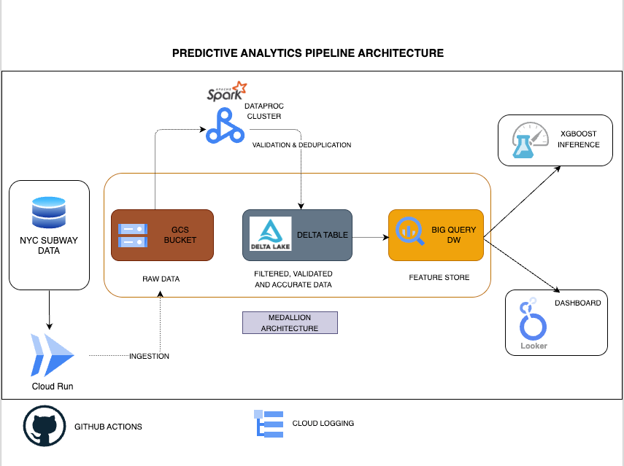
Tech Stack and Architecture Diagram

Slide 6

Github link and Demo
https://github.com/krishnasurya1110/capstone-project/tree/main

Slide 7
Thank you

